Slide 1
Price analysis and recommendation based on Competition for Big Mountain Resort
Presented by- Sanjana Panda

Slide 2
Problem background
Big Mountain Resort is located in north-western Montana.
Big Mountain Resort offers spectacular views of Glacier National Park and Flathead National Forest.
The resort originally opened in 1947 with an annual snowfall of 333 inches and 3,000 acres of skier and rider accessible terrain.
Big Mountain Resort offers access to 105 named trails and vast bowl and tree skiing.

Slide 3
Problem Identification
Recently, Big Mountain Resort installed a new chair lift.
This additional chair increases their operating costs by $1,540,000 this season.
Business profit margin should be within 9.2%.

Slide 4
Problem Statement Worksheet (Hypothesis Formation)
Big Mountain Resort recommendations in order to cover up the additional operating costs by $1,540,000/- over the season. Also, to forecast current years’ revenue if the recommendations are implemented.
H
1
Context
4
Constraints within solution space
Big Mountain Resort has recently installed an additional chair lift to help increase the distribution of visitors across the mountain. This additional chair increases their operating costs by $1,540,000 this season. The business is eager to get your recommendations on recouping the increased operating costs from the new chair this season.
Business profit margin should be within 9.2%.
Data might not be sufficient.
5
Stakeholders to provide key insight
Director of Operations, Jimmy Blackburn
2
Criteria for success
Recommendations to cover up $1,540,000/- of additional operation cost so as to keep the profit margin within 9.2%. Also, to forecast current years’ revenue if the recommendations are implemented.
6
Key data sources
3
Scope of solution space
CSV file that contains information from 330 resorts in the US that can be considered part of the same market.
For this analysis we are considering 330 resorts in US that are considered as competition.
H
D
E
I
P
Notes:
Hypothesis: Create a Hypothesis with an emphasis on SMART principles. (S – Specific, M – Measurable, A – Achievable, R – Realistic, T – Timebound). If you cannot do this, you do not have a good grasp on the business problem.
Context: With context, we have clearly identified the problem at hand and have elucidated on how our initiative may solve this problem, alongside the commercial implications this will have on the business.
Criteria for Success: Clearly defining the criteria for success ensures that the scope of your work is clearly defined and understood. Otherwise, if this isn’t defined – your work will never end which will result in mismatched expectations.
Scope of Solution Space: Scoping out the solution space ensures that the business initiative is SPECIFIC for a certain segment or area. This prevents solutions that have been developed being scaled and applied for all other business units that the solution may not be responsible or scalable for.
Constraints within Solution Space: Looking forward, what are the foreseeable problems we are likely to encounter? Could this be stakeholder resistance? Could this be we don’t have access to the right data?
Stakeholders to provide key insight: Who are the people I need to speak to, to get the answers I need for my data analysis?
What key data sources are required?
Based off my discussions with the key stakeholders – can we clearly list out all the data sources we need so we can make a highly targeted request as opposed to a scatter-gun approach where we ask for a bit of everything?

Slide 5
Recommendations
We have a dataset, of 330 resorts in the US that can be considered part of the same market.
Based on data provided, we are predicting price of Adults during the weekend such that it’s competitive with market.
Price we recommend is: $75.67/-, with a margin of $7.62/-.

Slide 6
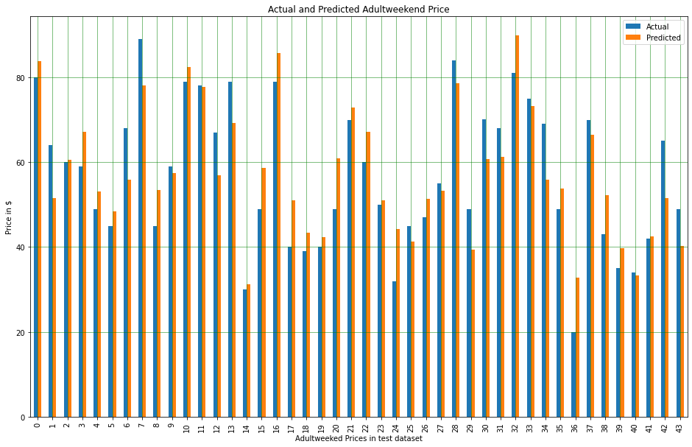
Predicted vs Actual Price of sample data

Slide 7
Model Summary and Analysis
Based on our model, there are few amenities that can really influence the price during weekend.
These amenities are as follows:
Skiable Terrain in ac
Terrain Parks
Chairs especially for a group of 2 to 4.

Slide 8
Summary
Based on analysis we have realised that reducing the cost for adults during weekend, using discounts, would make it competitive and might bring in more customers.
Improving amenities, like increasing chairs or skiable terrain, we can increase the prices and also provide premium services to our customers.

